Slide 1
Lecture 23: More Max Flow Applications
Nathan Brunelle

Slide 2
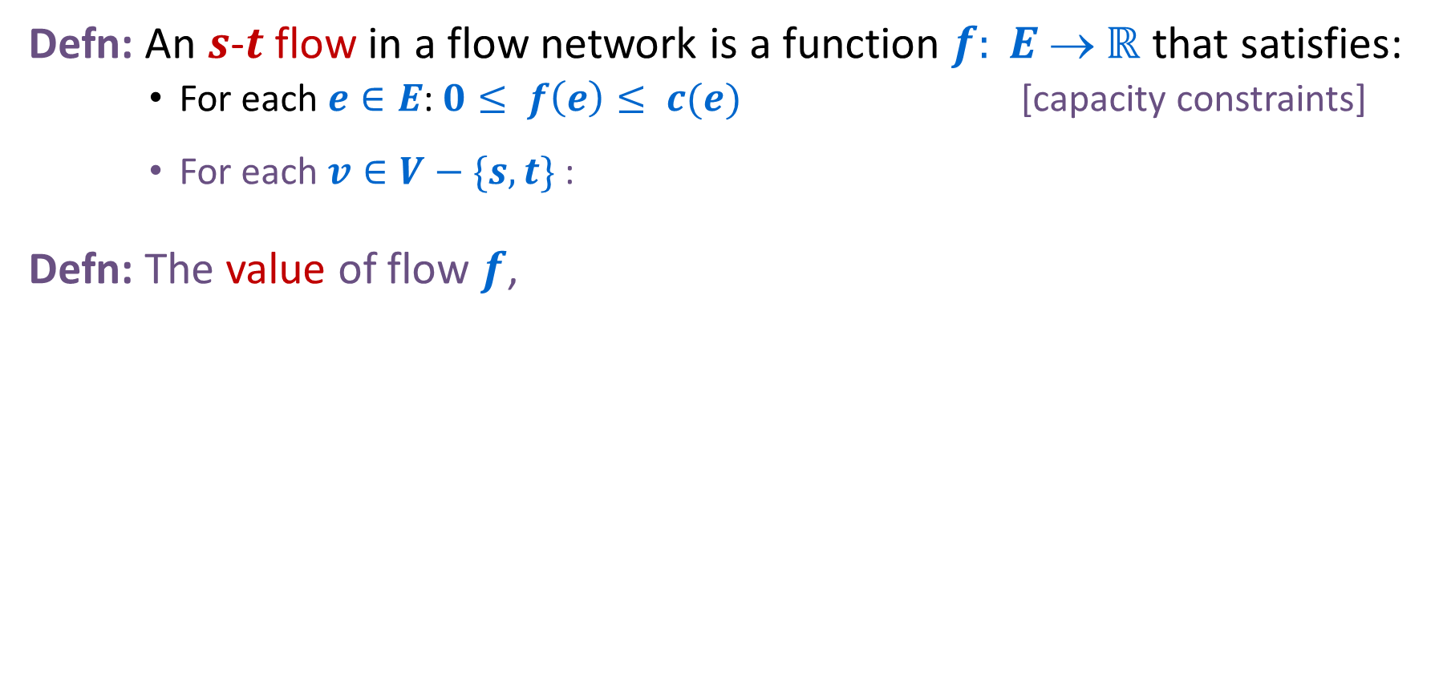

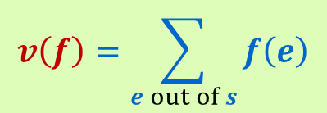
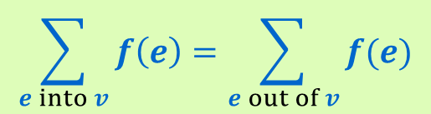
Flow Graph
Defn: An $s$-$t$ flow in a flow network is a function $f: E  ℝ$ that satisfies:
For each $e∈E$: $0≤ f\left(e\right)≤ c(e)$ [capacity constraints]
For each $v∈V−\{s,t\}$:
Defn: The value of flow $f$,
$$\sum_{e into v}{f\left(e\right)=\sum_{e out of v}{f(e)}}$$
[flow conservation]
a
6/9
d
$$v\left(f\right)=\sum_{e out of s}{f\left(e\right)}$$
10/10
4/4
15
15
6/10
s
3/5
b
8/8
e
8/10
t
Only show non-zero values of $f$
11/15
4
1/6
15
10/10
value = 24
c
11/30
f
Notes:
source = where material originates, sink = where material goes.
We use cut to mean s-t cut.

Slide 3
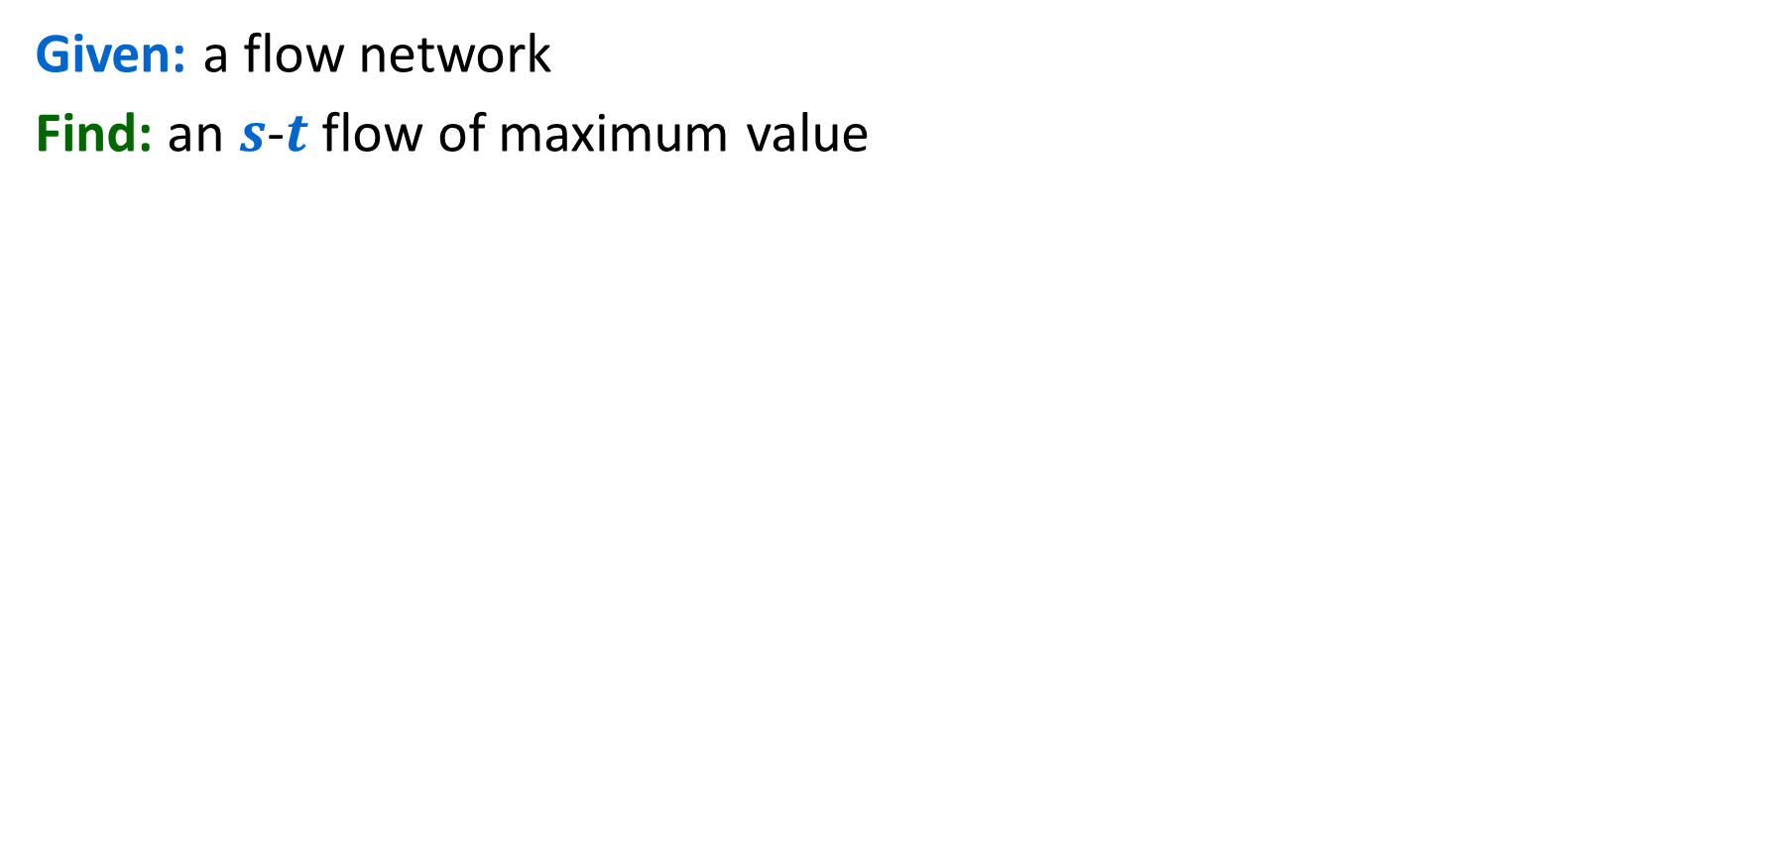
Maximum Flow Problem
Given: a flow network
Find: an $s$-$t$ flow of maximum value
a
6/9
d
10/10
4/4
15
15
6/10
s
3/5
b
8/8
e
8/10
t
11/15
4
1/6
15
value = 24
10/10
c
11/30
f
Notes:
source = where material originates, sink = where material goes.
We use cut to mean s-t cut.

Slide 4
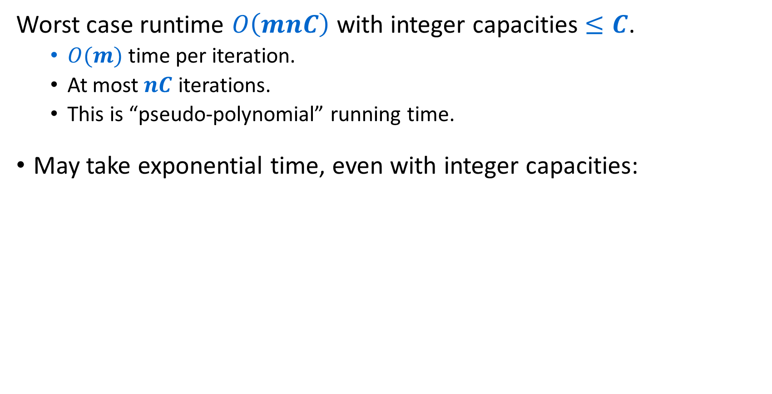
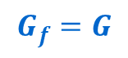
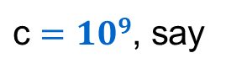
Ford-Fulkerson Running Time
Worst case runtime $O\left(mnC\right)$ with integer capacities $≤C$.
$O(m)$ time per iteration.
At most $nC$ iterations.
This is “pseudo-polynomial” running time.
May take exponential time, even with integer capacities:
$\text{c}=109$, say
1
1
1
a
c
a
c-1
a
c-1
c
c
c-1
s
1
t
s
1
t
s
1
t
etc.
c
c
c-1
c
c-1
c-1
b
b
b
1
$$G_{f}=G$$
1
1

Slide 5
Applications of Max Flow
Max flow is most useful when paired with reductions
Reduction idea:
Create an algorithm for a new problem by transforming it into a different problem that can be solved by a preexisting algorithm
Reduction Definition - A pair of procedures:
One that takes inputs for the new problem and transforms them into inputs for the old problem
One that takes solutions from the old problem and converts those into solutions for the new problem
Note: this second procedure only needs to apply to solutions to inputs that could possible come from the reduction (i.e. it does not have to work for every possible solution)
The way we’ll use max flow:
Start with a non max flow problem
Write a procedure to convert its input to a flow network
Use Ford-Fulkerson to find the max flow through the network
Use that max flow to find the solution to our non max flow problem.

Slide 6
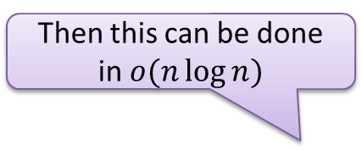
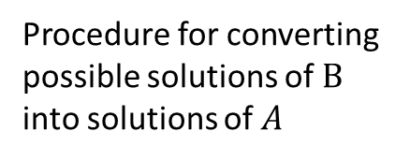
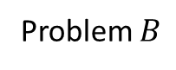
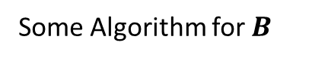
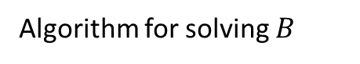
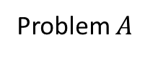

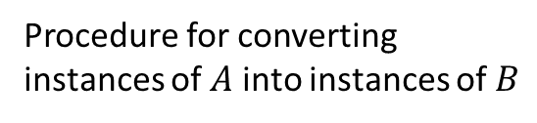

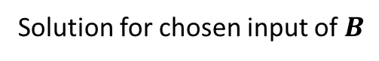

Reductions
Problem $A$
Problem $B$
$$A$$
$$B$$
Procedure for converting instances of $A$ into instances of $B$
Algorithm for solving $B$
Procedure for converting possible solutions of $B$ into solutions of $A$
Solution for $A$
Solution for chosen input of $B$
$$X$$
$$Y$$
Reduction

Slide 7
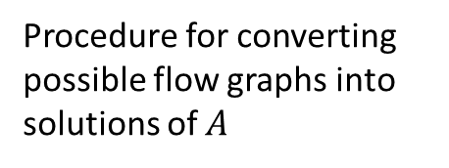
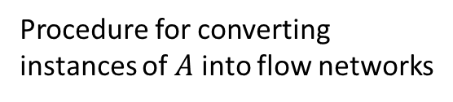
Max Flow Reductions
Problem $A$
Max Flow Problem
$$A$$
a
9
d
10
4
15
15
10
Procedure for converting instances of $A$ into flow networks
s
5
b
8
e
10
t
15
4
6
15
10
c
30
f
Ford-Fulkerson
Procedure for converting possible flow graphs into solutions of $A$
A maximal flow graph for that network
Solution for $A$
a
6/9
d
$$X$$
10/10
4/4
15
15
6/10
s
3/5
b
8/8
e
8/10
t
11/15
4
1/6
15
10/10
Reduction
c
11/30
f

Slide 8
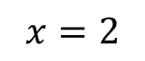
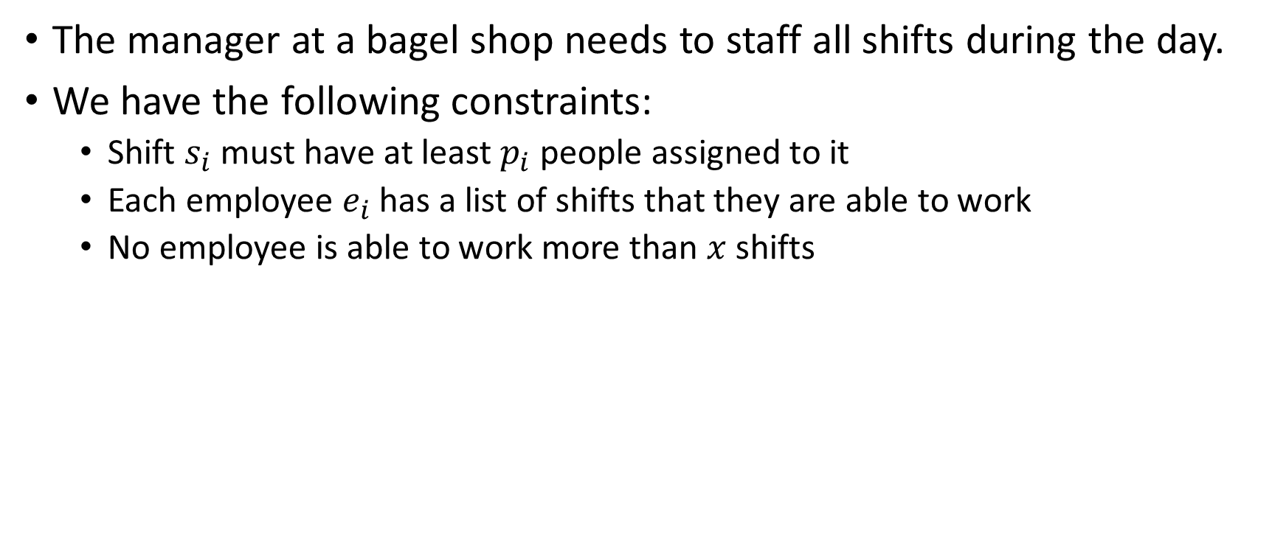
Shift Scheduling
The manager at a bagel shop needs to staff all shifts during the day.
We have the following constraints:
Shift $s_{i}$ must have at least $p_{i}$ people assigned to it
Each employee $e_{i}$ has a list of shifts that they are able to work
No employee is able to work more than $x$ shifts
Shifts:
6am, 2
9am, 2
12pm, 1
3pm, 1
Employees:
6am, 9am, 3pm
6am, 9am, 12pm
6am, 3pm
Solution:
Employee 1 assigned to 6am, 9am
Employee 2 assigned to 9am, 12pm
Employee 3 assigned to 6am, 3pm
$$x=2$$

Slide 9
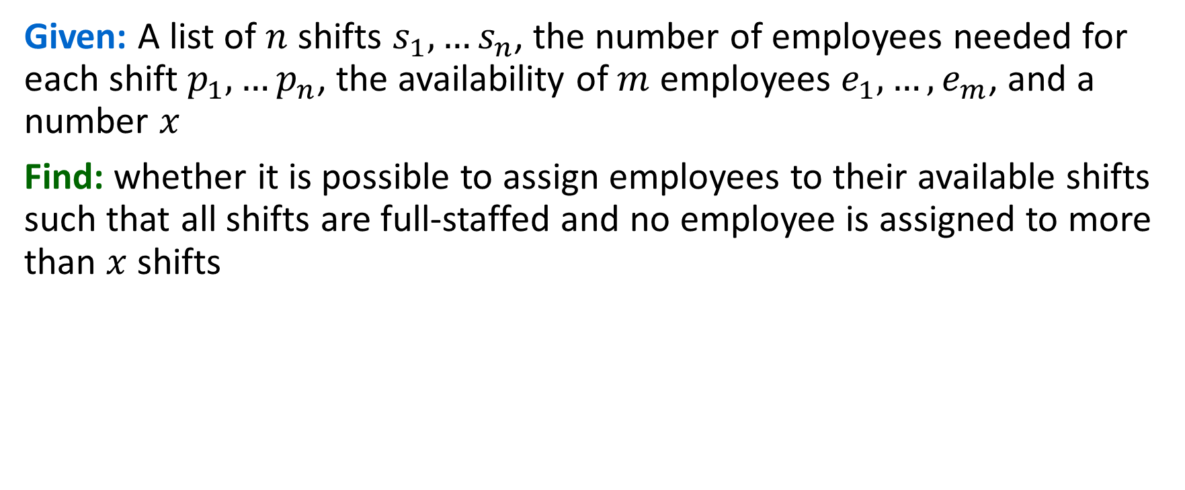
Shift Scheduling problem
Given: A list of $n$ shifts $s_{1},…s_{n}$, the number of employees needed for each shift $p_{1},…p_{n}$, the availability of $m$ employees $e_{1},…,e_{m}$, and a number $x$
Find: whether it is possible to assign employees to their available shifts such that all shifts are full-staffed and no employee is assigned to more than $x$ shifts
Shifts:
6am, 2
9am, 2
12pm, 1
3pm, 1
Employees:
6am, 9am, 3pm
6am, 9am, 12pm
6am, 3pm
Solution:
Employee 1 assigned to 6am, 9am
Employee 2 assigned to 9am, 12pm
Employee 3 assigned to 6am, 3pm
$$x=2$$

Slide 10
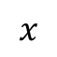
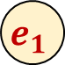
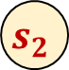
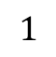

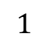

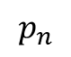
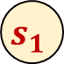
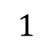
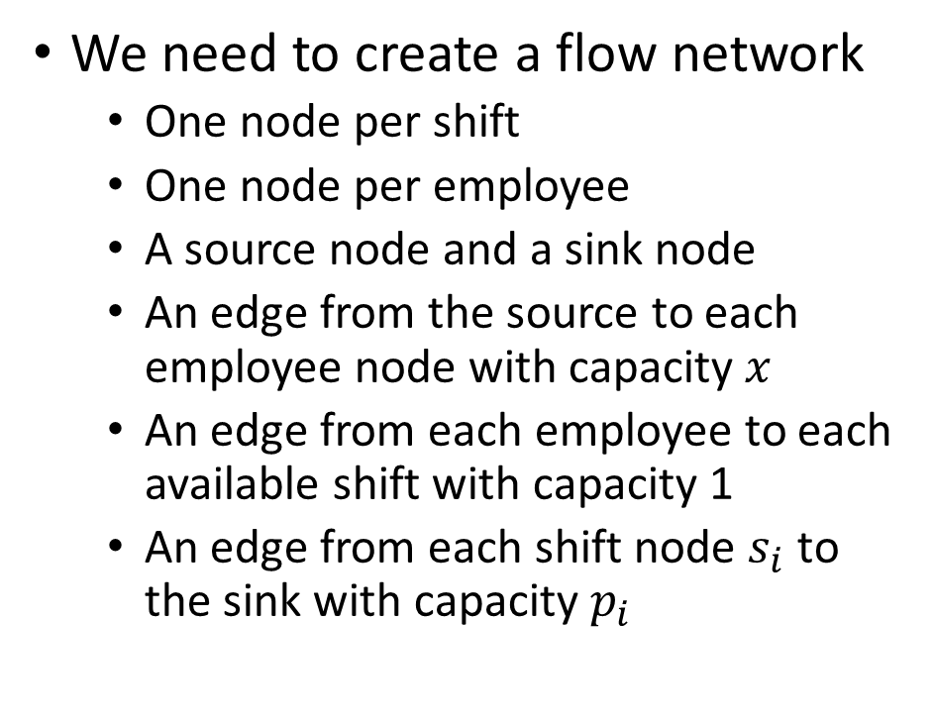
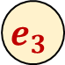
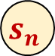
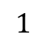
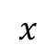
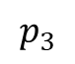

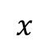
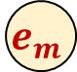

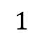
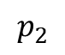
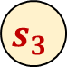

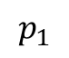
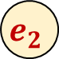
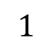

Reducing to Max Flow
We need to create a flow network
One node per shift
One node per employee
A source node and a sink node
An edge from the source to each employee node with capacity $x$
An edge from each employee to each available shift with capacity 1
An edge from each shift node $s_{i}$ to the sink with capacity $p_{i}$
$$e_{1}$$
$$1$$
$$s_{1}$$
$$1$$
$$x$$
$$p_{1}$$
$$e_{2}$$
$$1$$
$$s_{2}$$
$$x$$
$$1$$
$$p_{2}$$
$$s$$
$$t$$
$$1$$
$$x$$
$$p_{3}$$
$$e_{3}$$
$$1$$
$$s_{3}$$
…
…
$$p_{n}$$
$$x$$
$$1$$
$$1$$
$$e_{m}$$
$$1$$
$$s_{n}$$

Slide 11
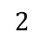
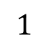




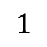
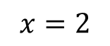


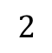

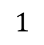
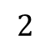
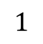






Reducing to Max Flow
Shifts:
6am, 2
9am, 2
12pm, 1
3pm, 1
Employees:
6am, 9am, 3pm
6am, 9am, 12pm
6am, 3pm
$$x=2$$
We need to create a flow network
One node per shift
One node per employee
A source node and a sink node
An edge from the source to each employee node with capacity $x$
An edge from each employee to each available shift with capacity 1
An edge from each shift node $s_{i}$ to the sink with capacity $p_{i}$
$$e_{1}$$
$$1$$
$$6$$
$$1$$
$$1$$
$$2$$
$$2$$
$$e_{2}$$
$$9$$
$$2$$
$$1$$
$$2$$
$$s$$
$$1$$
$$t$$
$$2$$
$$1$$
$$1$$
$$e_{3}$$
$$12$$
$$1$$
$$1$$
$$3$$

Slide 12




































Shift Scheduling Reduces to Max Flow
Max Flow Problem
Shift Scheduling
$$e_{1}$$
$$1$$
$$6$$
$$1$$
$$1$$
$$2$$
$$2$$
Shifts:
6am, 2
9am, 2
12pm, 1
3pm, 1
Employees:
6am, 9am, 3pm
6am, 9am, 12pm
6am, 3pm
$$2$$
$$e_{2}$$
$$1$$
$$9$$
$$2$$
$$s$$
$$1$$
$$t$$
Nodes: One per employee, One per shift, source, sink
Edges: s to employees with capacity $x$, employees to available shifts with capacity 1, shifts to sink with capacity $p_{i}$
$$1$$
$$2$$
$$1$$
$$e_{3}$$
$$12$$
$$1$$
$$1$$
$$3$$
$$x=2$$
Ford-Fulkerson
A maximal flow graph for that network
Schedule
If an employee-shift edge has flow, assign the employee to that shift
$$e_{1}$$
$$1/1$$
$$6$$
$$1$$
1/$1$
Solution:
Employee 1 assigned to 6am, 9am
Employee 2 assigned to 9am, 12pm
Employee 3 assigned to 6am, 3pm
$$2/2$$
$$2/2$$
$$2/2$$
$$e_{2}$$
$$1/1$$
$$9$$
$$2/2$$
$$s$$
$$1/1$$
$$t$$
$$2/2$$
$$1/1$$
$$1/1$$
Reduction
$$e_{3}$$
$$12$$
$$1/1$$
1/$1$
$$3$$

Slide 13

Running Time
Constructing the graph
Nodes: $n+m+2$
Edges: not more than $n⋅m$
Largest capacity: $C=\max\left(x, p_{1},…,p_{n}\right)$
Running Max Flow
$Θ\left(Cn^{2}m+Cnm^{2}\right)$
$$e_{1}$$
$$1$$
$$s_{1}$$
$$1$$
$$x$$
$$p_{1}$$
$$e_{2}$$
$$1$$
$$s_{2}$$
$$x$$
$$1$$
$$p_{2}$$
$$s$$
$$t$$
$$1$$
$$x$$
$$p_{3}$$
$$e_{3}$$
$$1$$
$$s_{3}$$
…
…
$$p_{n}$$
$$x$$
$$1$$
$$1$$
$$e_{m}$$
$$1$$
$$s_{n}$$

Slide 14

Correctness
Valid flow $⇒$ Valid answer
No employee is assigned to more than $x$ shifts (capacity on $s$ to $e_{i}$)
No employee is assigned to the same shift more than once (capacity of $e_{i}$ to $s_{j}$)
No employee is assigned to an unavailable shift (by selection of edges to draw)
All shifts staffed if flow value is $\sum{p_{i}}$
Valid answer $⇒$ Valid flow
Suppose we had a way of staffing the shifts, we will show that there must be flow through the graph whose value matches $∑p_{i}$
All capacity constraints will be observed
It will only use edges we drew
It will assign flow across $∑p_{i}$ $e_{i}$-to-$s_{j}$ shifts
$$e_{1}$$
$$1$$
$$s_{1}$$
$$1$$
$$x$$
$$p_{1}$$
$$e_{2}$$
$$1$$
$$s_{2}$$
$$x$$
$$1$$
$$p_{2}$$
$$s$$
$$t$$
$$1$$
$$x$$
$$p_{3}$$
$$e_{3}$$
$$1$$
$$s_{3}$$
…
…
$$p_{n}$$
$$x$$
$$1$$
$$1$$
$$e_{m}$$
$$1$$
$$s_{n}$$

Slide 15












Reductions and Correctness
A valid answer to the chosen problem $B$ input produces a valid answer to the original problem $A$
Our reduction produces a meaningful result
A valid answer to the original problem $A$ results in a valid answer to the chosen problem $B$ input
If there was a better answer for $A$, then the algorithm for $B$ would have found it
Problem $A$
Problem $B$
$$A$$
$$B$$
Procedure for converting instances of $A$ into instances of $B$
Algorithm for
solving $B$
Procedure for converting possible solutions of $B$ into solutions of $A$
Solution for $A$
Solution for chosen
input of $B$
$$X$$
$$Y$$
Reduction

Slide 16

Recall: Bipartite Graph
Definition: An undirected graph $G$ is bipartite iff we can color its vertices red and green so each edge has different color endpoints
Alternative: A graph $G$ is bipartite iff we can find a cut $\left(L,R\right)$ such that every edge in the graph crosses the cut
On a cycle the two colors must alternate, so
green every 2nd vertex
red every 2nd vertex
Can’t have either if length is not divisible by 2.

Slide 17

Bipartite Matching
Input: Undirected Bipartite graph $G=(L∪R, E)$
Goal: Find the largest subset of edges $M⊆E$ such that ever vertex is adjacent to at most one edge

Slide 18




Maximum Bipartite Matching
Dog Lovers
Dogs

Slide 19
Maximum Bipartite Matching
Dog Lovers
Dogs
A (non-maximum) bipartite matching

Slide 20
Maximum Bipartite Matching
Dog Lovers
Dogs
A maximum bipartite matching!

Slide 21
Reducing to Max Flow
We need to create a flow network
Add/remove any edges/nodes as needed (must be directed)
Identify a source/sink
Give capacities to each edge

Slide 22

Reducing to Max Flow
We need to create a flow network
Add/remove any edges/nodes as needed
Make each edge directed from $L$ to $R$
Add nodes $s$ and $t$
Draw an edge from $s$ to each node in $L$
Draw an edge from each node in $R$ to $t$
Identify a source/sink
Make $s$ the source and $t$ the sink
Give capacities to each edge
Give each edge capacity 1
1
1
1
1
1
1
1
1
1
1
$$s$$
1
$$t$$
1
1
1
1
1
1
1

Slide 23

Reducing to Max Flow
Next, run Edmonds-Karp
Use the answer to select a Matching
$M=$ the set of $L$-to-$R$ edges with flow
$M=\left\{e :e∈L×R, f\left(e\right)=1\right\}$
Running Time:
Constructing the graph
$\left|V\right|+|E|$
Running Ford-Fulkerson
$\left|V\right|⋅|E|$
Finding $M$
$\left|V\right|$
Overall
$Θ\left(\left|V\right|⋅\left|E\right|\right)$
1
1/1
1
1/1
1
1/1
1/1
1/1
1/1
1/1
$$s$$
1
$$t$$
1/1
1
1/1
1/1
1/1
1/1
1

Slide 24

Correctness
Valid flow $⇒$ Valid answer
Need to show: $M$ is a valid match
Requirement 1: $M⊆E$
Requirement 2: each node is part of at most one match
No node in $L$ is adjacent to more than one edge because the capacity of the edge from $s$ is 1
No node in $R$ is adjacent to more than one edge because the capacity of the edge to $t$ is 1
Valid answer $⇒$ Valid flow
Any matching $M$ enables a flow with value equal to $\left|M\right|$
Idea: “reverse” the construction to derive a flow from the match
For each edge in $M$, assign flow across that edge, then add flow incoming to each $L$ endpoint and outgoing form each $t$ endpoint
This must be a valid flow because
No edge exceeds its capacity (we only assign 1 unit)
All nodes (except $s$ and $t$) have $0$ net flow because each node is incident at most one edge in $M$
1
1/1
1
1/1
1
1/1
1/1
1/1
1/1
1/1
$$s$$
1
$$t$$
1/1
1
1/1
1/1
1/1
1/1
1

Slide 25

Edge-Disjoint Paths
Defn: Two paths in a graph are edge-disjoint iff they have no edge in common.
Edge disjoint path problem: Given: a directed graph $G=(V,E)$ and two vertices $s$ and $t$. Find: the maximum # of edge-disjoint simple $s$-$t$ paths in $G$.
a
d
s
b
e
t
c
f

Slide 26

Edge-Disjoint Paths – Example of size 2
Defn: Two paths in a graph are edge-disjoint iff they have no edge in common.
Edge disjoint path problem: Given: a directed graph $G=(V,E)$ and two vertices $s$ and $t$. Find: the maximum # of edge-disjoint simple $s$-$t$ paths in $G$.
a
d
s
b
e
t
c
f

Slide 27






Edge-Disjoint Paths
MaxFlow for edge-disjoint paths
Assign capacity $1$ to every edge
Add a source $s′$ and a sink $t′$
Connect $s′$ to $s$ and $t′$ to $t$ with capacity $m$ (number of edges)
At most every edge is its own path
Compute max flow
Use all edges with flow
Running Time:
Constructing the flow network: $O(n+m)$
Computing Max Flow: $O(nm^{2})$
Overall: $Θ\left(nm^{2}\right)$
a
1
d
1
1
1
1
1
$$s′$$
$$m$$
1
1
$$m$$
s
b
e
t
$$t′$$
1
1
1
1
1
c
1
f

Slide 28







Edge Disjoint Paths Reduction to Max Flow
Max Flow Problem
Edge Disjoint Paths
a
d
1
1
1
1
1
a
d
1
1
$$s′$$
$$m$$
s
b
e
1
t
$$m$$
$$t′$$
1
1
1
1
1
Add a new source and sink, add edge from new source to S with capacity $m$, edge from $t$ to new sink with capacity $m$, add capacity 1 to all original edges
s
b
e
t
c
1
f
c
f
Ford-Fulkerson
A maximal flow graph for that network
a
d
If an employee-shift edge has flow, assign the employee to that shift
1/1
a
1
d
1
1/1
1
1
1/1
s
b
e
t
$$s′$$
s
1/1
b
e
t
$$t′$$
$$2/m$$
1/1
1/1
1/1
$$2/m$$
1
1/1
c
1/1
f
c
f
Reduction

Slide 29






Edge-Disjoint Paths
Theorem: MaxFlow $=$ # edge-disjoint paths
Valid flow $⇒$ Valid answer:
Need to show: no edge is used more than once, all paths go from $s$ to $t$
Each edge has capacity 1, so it’s used once. To get from $s′$ to $t′$ we must go from $s$ to $t$ along the way
Valid answer $⇒$ Valid flow:
Need to show: Any set of edge-disjoint paths could be used to produce flow of the same amount.
Add 1 unit of flow along each path. Since no path uses the same edge twice, capacity constraint is satisfied. Because the indegree matches the outdegree for each node (except $s′$ and $t′$), the flow constraint is satisfied.
MaxFlow for edge-disjoint paths
Assign capacity $1$ to every edge
Add a source $s′$ and a sink $t′$
Connect $s′$ to $s$ and $t′$ to $t$ with capacity $m$
Compute max flow
Use all edges with flow
a
1
d
1/1
1/1
1
1
1
$$s′$$
$$m$$
1/1
1/1
$$m$$
$$t′$$
s
b
e
t
1
1/1
1/1
1/1
1/1
c
1/1
f

Slide 30

Vertex-Disjoint Paths
Defn: Two paths in a graph are vertex-disjoint iff they have no vertices in common, except their end points.
Vertex disjoint path problem: Given: a directed graph $G=(V,E)$ and two vertices $s$ and $t$.
Find: the maximum # of vertex-disjoint simple $s$-$t$ paths in $G$.
a
d
s
b
e
t
c
f

Slide 31



Vertex-Disjoint Paths
Defn: Two paths in a graph are vertex-disjoint iff they have no vertices in common.
Vertex disjoint path problem: Given: a directed graph $G=(V,E)$ and two vertices $s$ and $t$.
Find: the maximum # of vertex-disjoint simple $s$-$t$ paths in $G$.
a
d
Observation: Every vertex-disjoint path is also edge-disjoint.
(Two paths which share an edge also share that edge’s endpoints)
Idea: Modify the graph so that all edge-disjoint paths are also vertex disjoint
s
b
e
t
c
f
$$a$$
$$a_{out}$$

Slide 32
Vertex Disjoint Paths Reduction to Edge-Disjoint Paths
Edge Disjoint Paths
Vertex Disjoint Paths
a
d
a
d
s
b
e
t
Split each node into a “in” and “out” node. Add an edge from in to out
s
b
e
t
c
f
c
f
Reduction to Max Flow
Maximal set of Edge-disjoint paths
Recombine the split nodes
a
d
a
d
s
b
e
t
s
b
e
t
Reduction
c
f
c
f

Slide 33


Vertex-Disjoint Paths Running time
Reduction for vertex-disjoint paths
For each node $v$, add in $v_{out}$
For every outgoing edge from $v$, instead make it an outgoing edge from $v_{out}$
Add edge $(v, v_{out})$
Compute edge-disjoint paths
Running Time:
Constructing the new graph: $O(n+m)$
Computing edge disjoint paths: $O\left(nm^{2}\right)$
Overall: $O\left(nm^{2}\right)$
a
d
b
e
t
c
f

Slide 34


Vertex-Disjoint Paths
Theorem: # vertex-disjoint paths $=$ # edge-disjoint paths
Valid set of edge-disjoint paths $⇒$ Valid set of vertex-disjoint paths:
Need to show: if no edge is used more than once then no vertex is used more than once
Any path that passes through a node $v$ must use the edge $\left(v,v_{out}\right)$, so if no edge is used more than once, then that includes these new edges we added, so no vertex can be used more than once either.
Valid set of vertex-disjoint paths $⇒$ Valid set of edge-disjoint paths :
Need to show: Any set of vertex-disjoint paths could be a set of edge-disjoint paths of the same size
All vertex-disjoint paths are edge disjoint
Reduction for vertex-disjoint paths
For each node $v$, add in $v_{out}$
For every outgoing edge from $v$, instead make it an outgoing edge from $v_{out}$
Add edge $(v, v_{out})$
Compute edge-disjoint paths
a
d
s
b
e
t
c
f

Slide 35
Final reminders
HW7 due Wednesday 11/26 @ 11:59pm
Quiz 2 on Friday 11/21 in class Practice Quiz is available Review in Wednesday’s class
I have OH now-12:30pm:
Meet at front of classroom, we’ll walk over together
CSE (Allen) 434 if you’re coming later
Glenn has online OH 12–1pm

